Slide 1
Wildfires in the United States
Sagnik Rana
Daniel Lesser
95-885 Data Science and Big Data

Slide 2
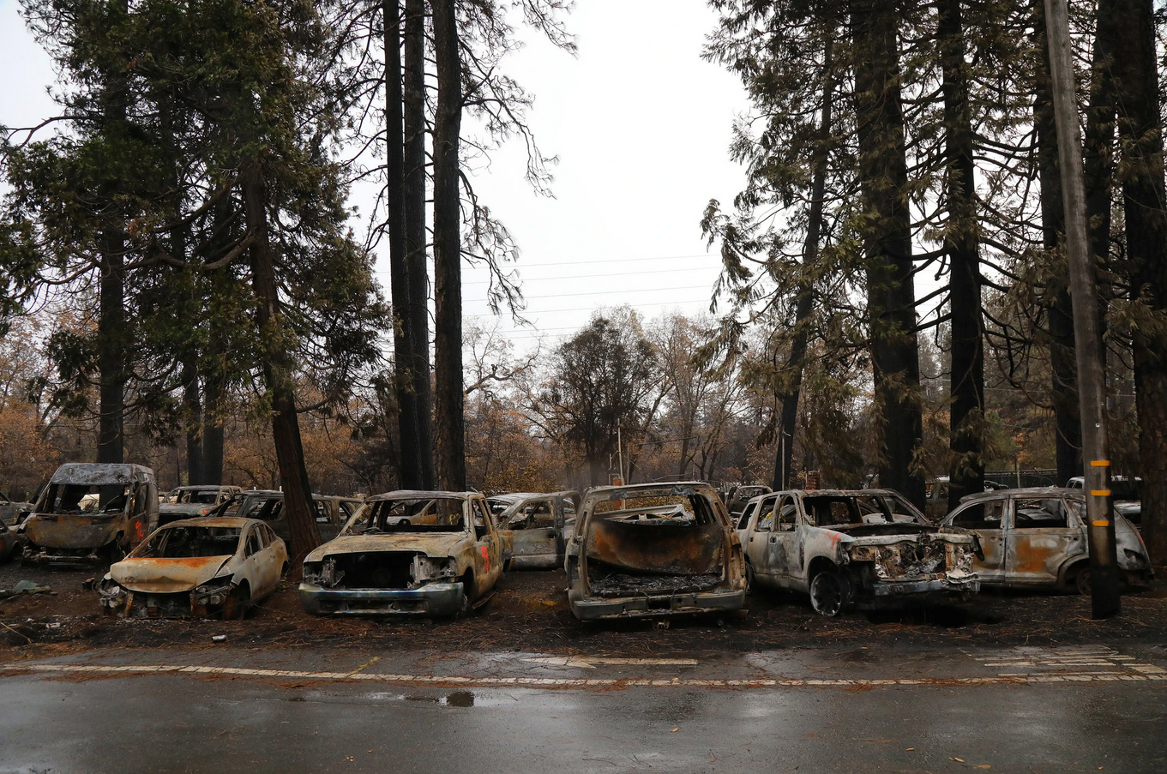
The problem
Wildfire severity and impact on human life appears to be on the rise
Recent high profile fires in California (Camp Fire, Mendocino Complex) have led to increased public awareness
The fires have led to loss of life, reduction of habitat, financial loss and increased political discourse

Slide 3
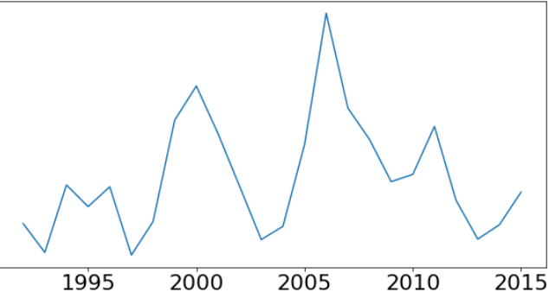
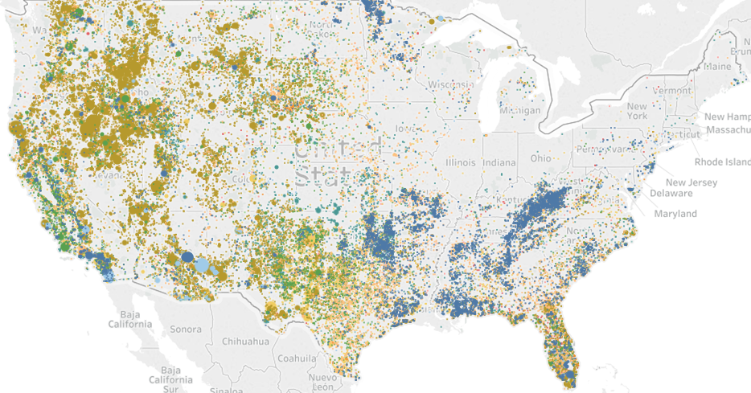
The questions
Has wildfire frequency increased over time?
What states are the biggest contributors to wildfires nationwide?
What are the biggest causes of wildfires? Do these causes differ by state?
What times of the year are wildfires most likely to occur?
Are annual rainfall totals an indicator of wildfire frequency?
Place holder for wildfire frequency by month and/or rainfall chart
Notes:
Additional sub-questions:
When measuring wildfire frequency, should consider count vs. total acreage burned.
Are there certain hot spots that have been overlooked? What states have seen the biggest increases? Decreases? Are there lessons to be learned?
Are wildfires occurring during a wider time frame each year?

Slide 4
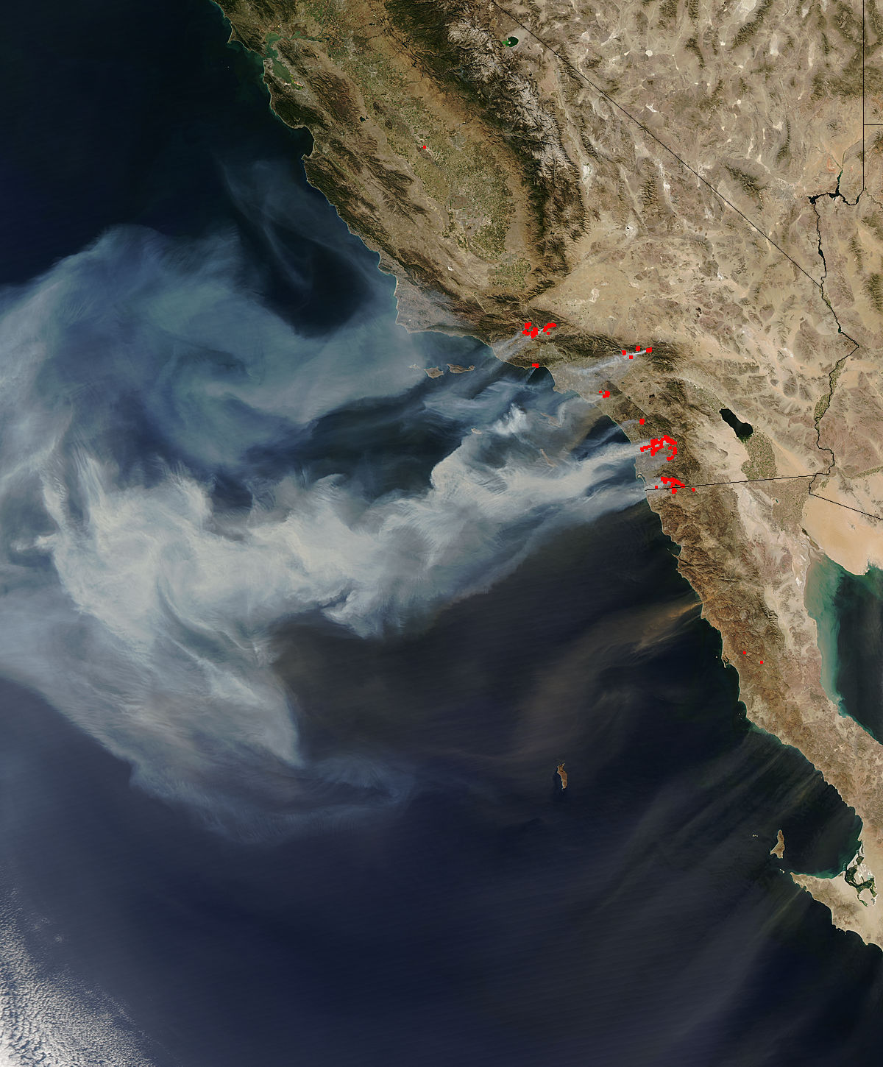
The hypotheses
That wildfire frequency has not only increased over time, but that the rate of increase is accelerating
That California and the west coast are the hardest hit states
That humans and preventable causes are the leading contributor to wildfires
That wildfires are occurring during more months of the year
That rainfall is a strong indicator of wildfire severity and that climate change may be a factor in the increase of wildfires
Notes:
Additional sources / prior research:
U.S. Forest Service has produced research papers on the impact of Climate Change on Wildfires. https://www.srs.fs.usda.gov/news/545
University of California including several publications. https://ucanr.edu/sites/forestry/Wildfire/

Slide 5




The data
Cooperative Fire Program Analysis conducted by USDA and DOI
Integrated reporting of Wildfire information 1992-2015 with 1.9m records
39 features including location, cause, size and agencies
Acquired from Kaggle.com
State sizes in square miles
Web scraped from netstate.com
U.S. Hourly precipitation
National Oceanic and Atmospheric Administration
5,500 observation stations
Hourly precipitation 1940-present

Slide 6
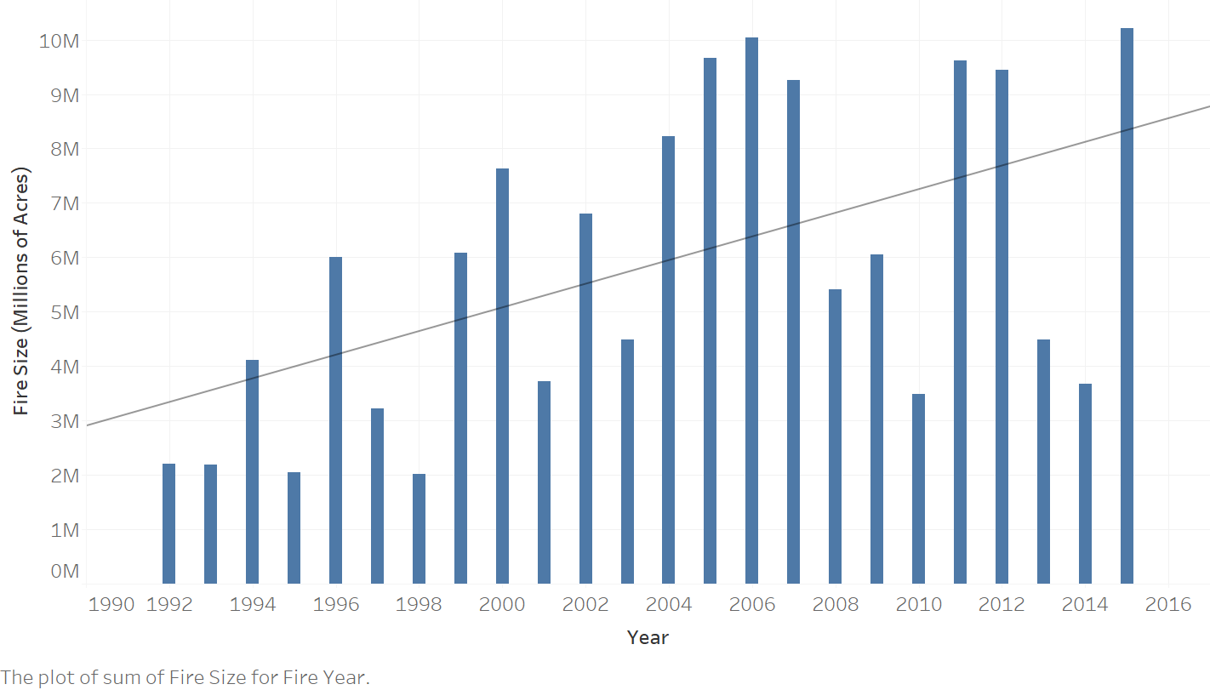
Wildfire frequency has not increased over time, but the size of fires has

Slide 7
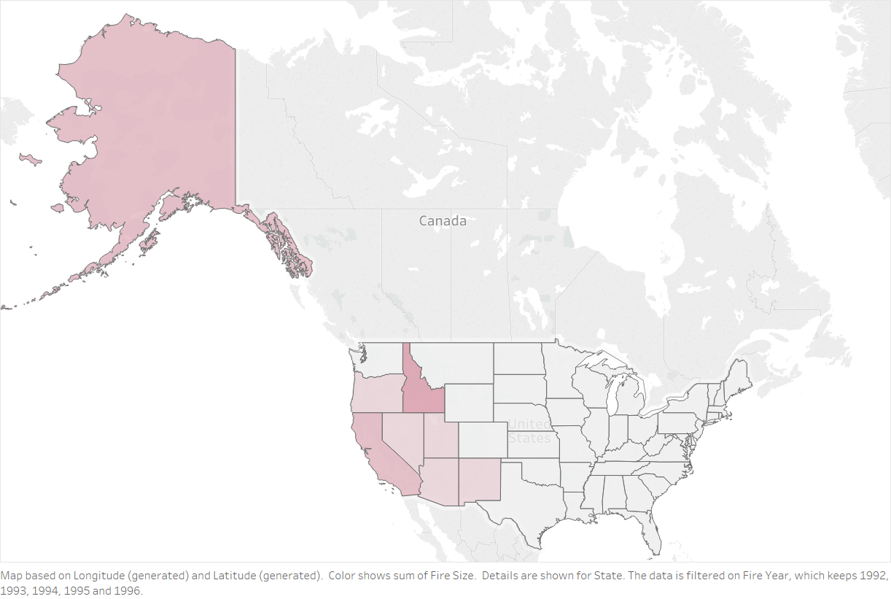
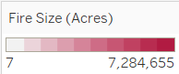
The West Coast has been the biggest contributors to wildfires in the U.S.
1992
-
1996

Slide 8
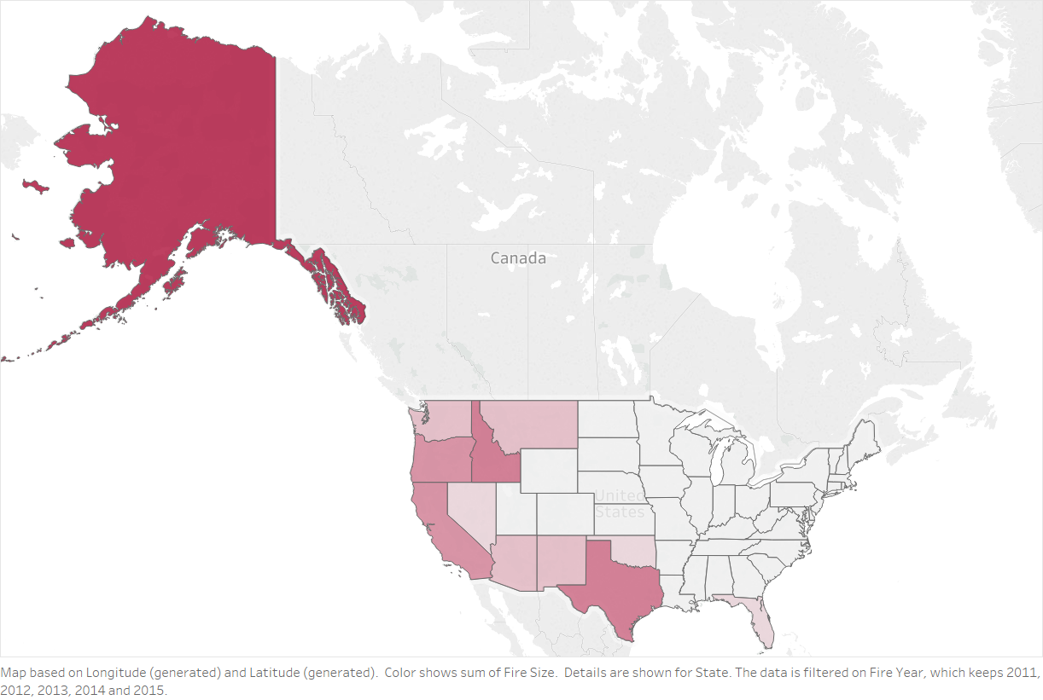
The West Coast has been the biggest contributors to wildfires in the U.S.
2012
-
2015
Notes:
Idaho has most amount of land burned per year (1.5%). Mostly federal land. Led to question of why…?
What is unique about Florida as the only east coast state? Mostly lightning, but other issue

Slide 9
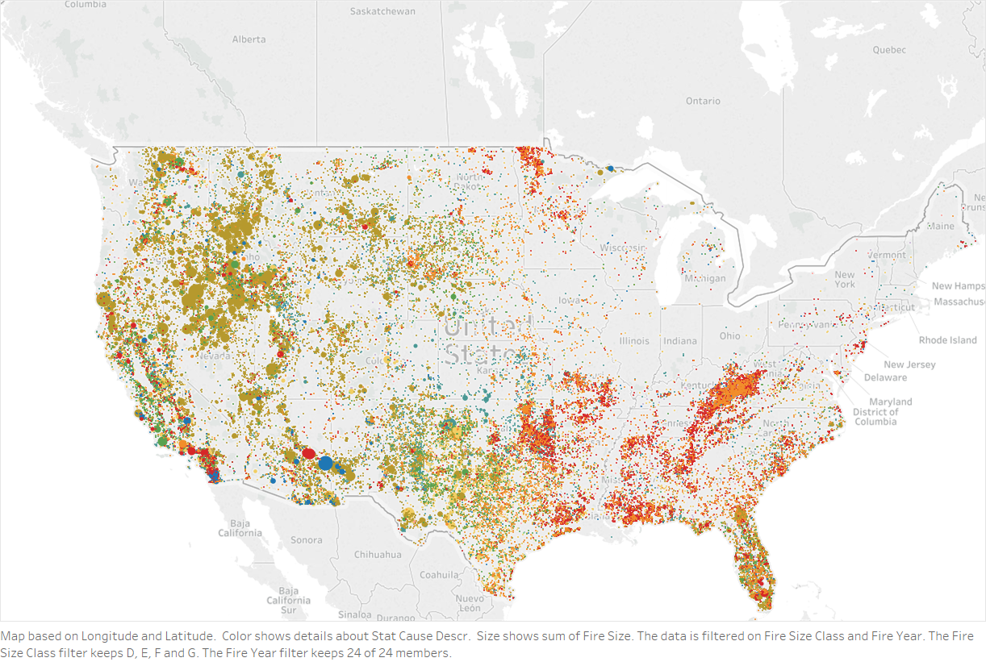
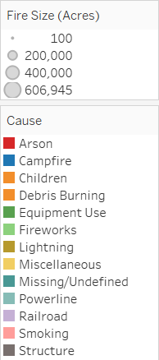
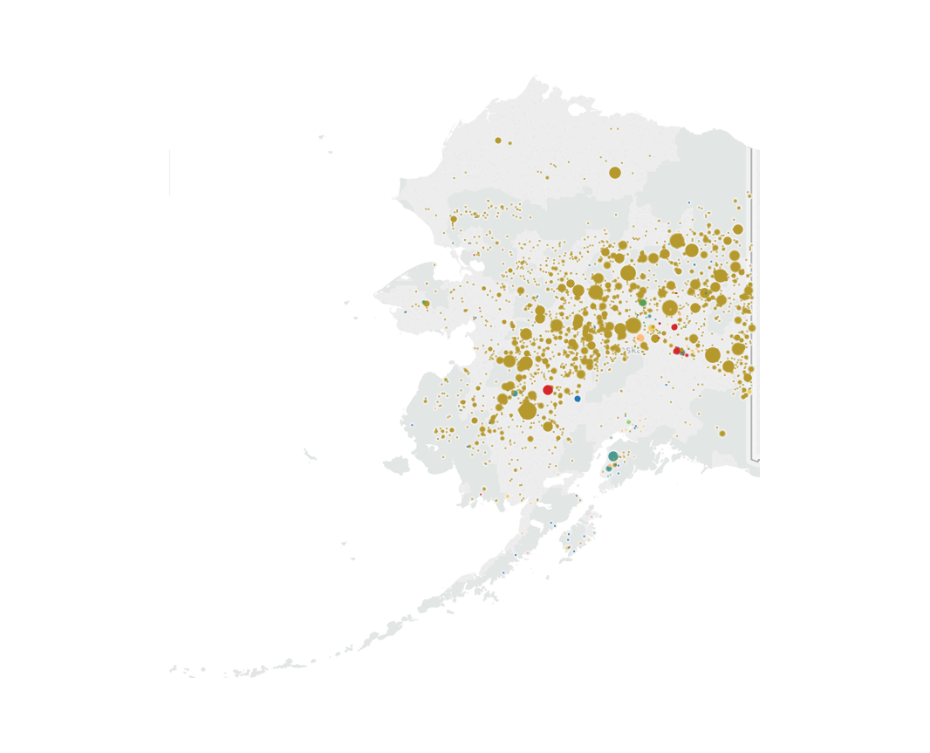
Lightning is the leading cause of wildfires
Notes:
Lighting strikes are the biggest driver wildfires by acreage in every year and are the key drivers in 2004-2007, 2012 and 2015. The number of acres burned due to lightning tripled during the 4 years 2004-2007 vs. the prior four years. Lightning accounted for 71% of wildfire land burned during those four years (long term average 59%).

Slide 10
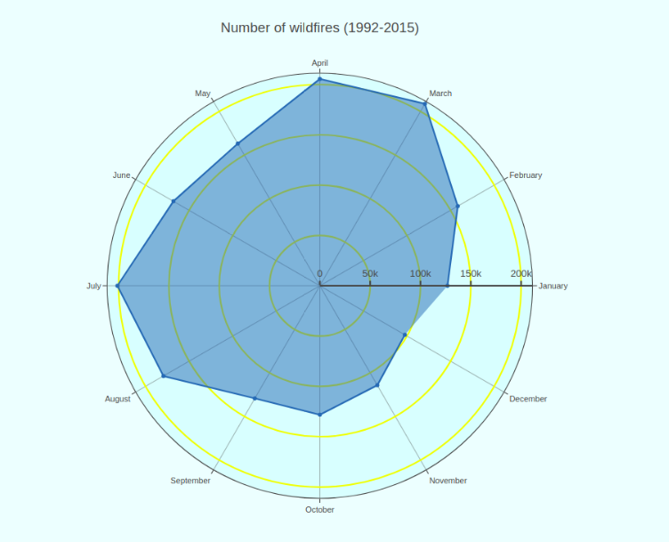
Wildfires occur most frequently in the spring and late summer

Slide 11
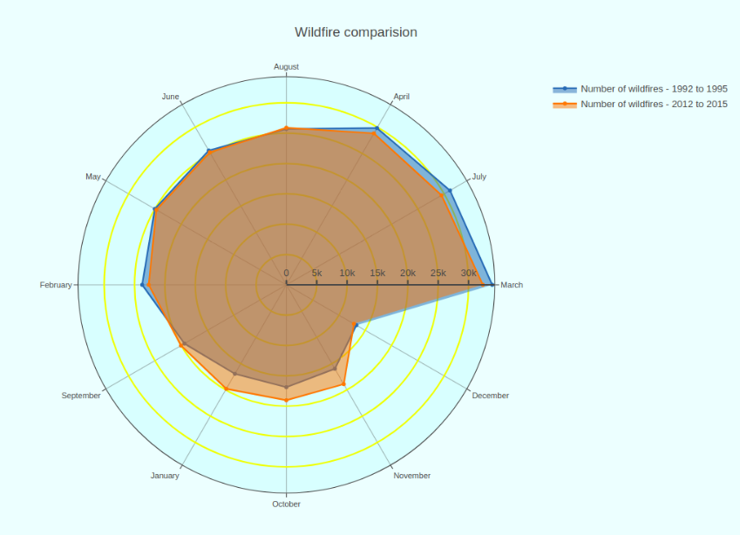
There is a small shift in frequency of wildfires in months over time

Slide 12
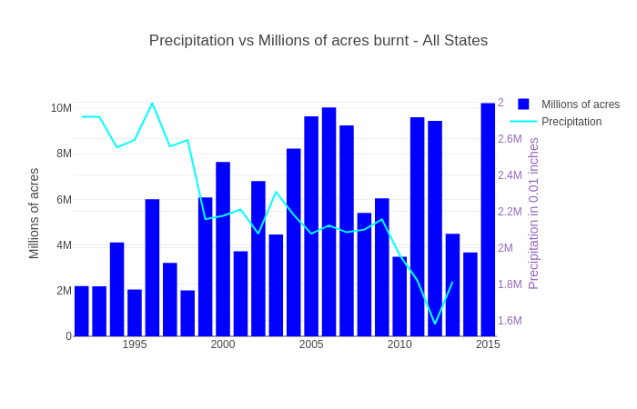
Is rainfall affecting the size of wildfires ?

Slide 13
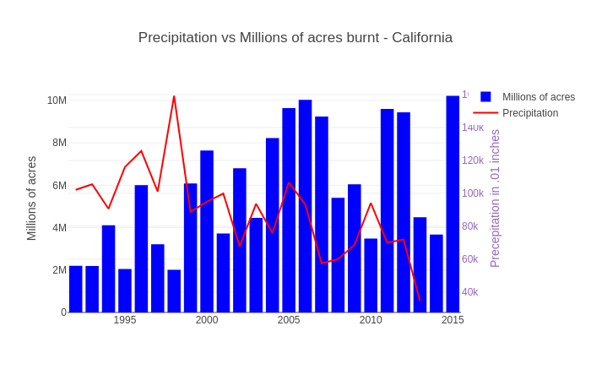
Size vs Rainfall - California

Slide 14
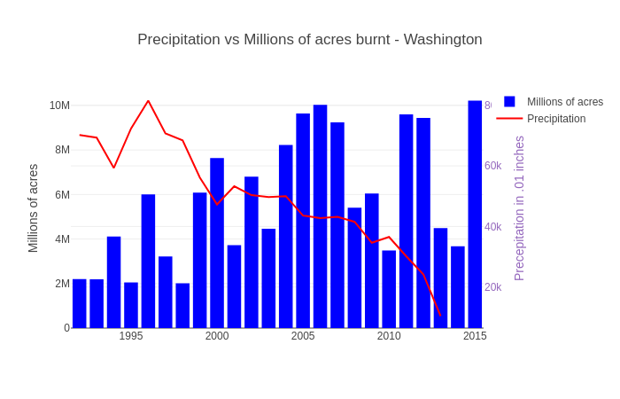
Size vs Rainfall - Washington

Slide 15
Conclusion / takeaways / suggestions
Fire frequency has not changed, but the severity has increased
The greatest cause of wildfires is not preventable, but severity can be reduced through improved monitoring and planning
Some states have made greater strides than others in reducing preventable fires, implying the opportunity for targeted policy changes.
In terms of month, spring and late summer remains riskiest month for the entire year. Special law reinforcement should must be imposed during these months.
Global warming has always been problematic for environment. If we are able to curb the issue less rainfall collectively, we can see the reduction in forest fires.
Notes:
Where targeted improvements? Texas, California, Alabama, Arizona

Slide 16
Sources
https://www.nytimes.com/2018/11/29/us/victims-california-fires-missing.html
https://proxy.duckduckgo.com/iu/?u=http%3A%2F%2Fwww.proshiksha.com%2Fwp-content%2Fuploads%2F2017%2F04%2FGrowth-icon-300x300.png&f=1
https://www.nasa.gov/images/content/193857main_wildfire_oct22_full.jpg

